Slide 1

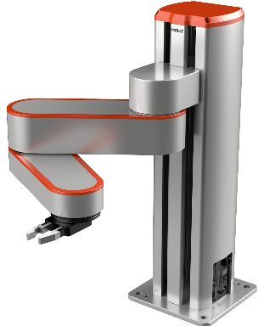
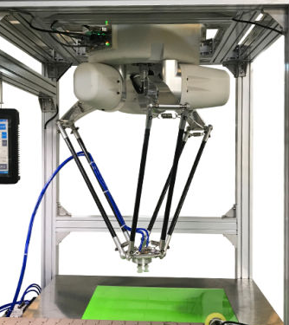
Need of Mathematical Model of a Robot:
A robot is a dead object. It does not know where are its different limbs (links). The living beings- human beings and
Animals- automatically know where are there head or leg. A robot cannot. So a mathematical model of a robot
represents the robot completely. Such a model helps to move the different limbs of the robot appropriately.
Industrial Robot:
Industrial robot refers to manipulators. Two types of manipulators are there- open loop and closed loop.
Open Loop Manipulator-SCARA Robot from Hitbot
(https://www.alibaba.com/product-detail)
Closed Loop Manipulator-DELTA Robot
(https://m.made-in-china.com/product)
Another classification: Planar manipulator and spatial manipulator. Planar manipulator moves in a plane; a spatial
manipulator moves in 3-D space. A planar manipulator has maximum 3 DOF and a spatial one has max of 6 DOF.

Slide 2
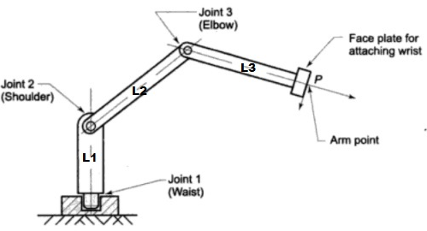

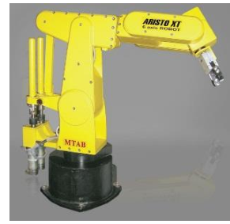
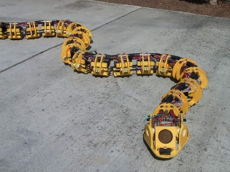

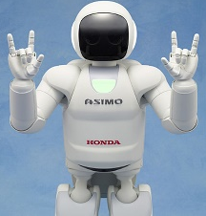
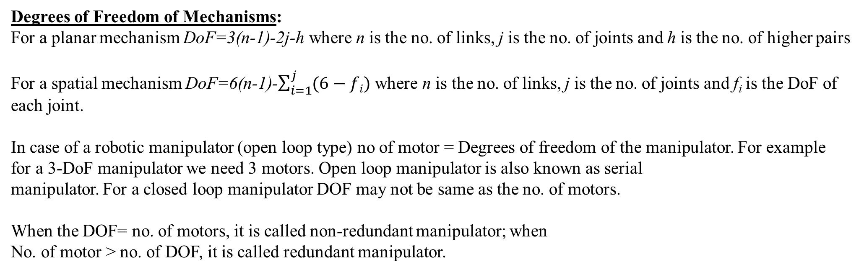
Degrees of Freedom of Mechanisms:
For a planar mechanism DoF=3(n-1)-2j-h where n is the no. of links, j is the no. of joints and h is the no. of higher pairs
For a spatial mechanism DoF=6(n-1)-$\sum_{i=1}^{j}{(6−fi) }$where n is the no. of links, j is the no. of joints and f_{i} is the DoF of
each joint.
In case of a robotic manipulator (open loop type) no of motor = Degrees of freedom of the manipulator. For example
for a 3-DoF manipulator we need 3 motors. Open loop manipulator is also known as serial
manipulator. For a closed loop manipulator DOF may not be same as the no. of motors.
When the DOF= no. of motors, it is called non-redundant manipulator; when
No. of motor > no. of DOF, it is called redundant manipulator.
Non-redundant manipulators
Redundant manipulators
3-DOF manipulator;
3 motors required
SCARA, 4 DOF; 4 motors Delta, 3 DOF; 3 motors Aristo; 6 DOF; 6 motors
(https://www.semanticscholar.org/paper/)
Snake robot, 3 DOF; ~21 motors SONY Dog-Aibo, 6 DOF; ~22 motors Honda ASIMO; 6 DoF, 34 motors
(https://www.skyfilabs.com/project-ideas/robotic-snake-using-arduino) https://en.wikipedia.org/wiki/AIBO https://www.theverge.com/2018/

Slide 3
DH- Parameters: To make the mathematical model of a manipulator, frames are fixed to each of the links of the
manipulator. If we can express one link with respect to previous link, then we can express the end link (called
end-effecter) with respect to the base link. This is called the forward kinematic model. DH-parameters help to
express one link with respect to another link mathematically.

Slide 4
DH- Parameters:
Two links are there- link i and
link i-1.
Frame i is attached to link i
and frame i-1 is attached to
link i-1.
a_{i} (link length): It is the distance
along X_{i} from the point of
intersection between Z_{i-1} and X_{i}
to the origin of frame i.
α_{i} (link twist): It is the angle between
Z_{i-1} and Z_{i} measured about X_{i}.
di (joint distance): It is the distance along
Z_{i-1} from the origin of frame i-1 to the point
of intersection between Z_{i-1} and X_{i}.
θ_{i} (joint angle): It is the angle between
X_{i-1} to X_{i} measured about Z_{i-1}.

